Slide 1

Linear Algebra – Importance in Data Science

Slide 2
Data Science – A Definition
Data Science is the science which uses
Domain Expertise
Knowledge of Mathematics & statistics
Programming Skills
to
Extract meaningful information from data and making it available in a timely manner to support business decisions.

Slide 3
Data Science is ... the
Proactive use of Data and Advanced Analytics to Drive
Better Decision Making
Engage with Business
Work with Data
Analytic Breadth
Industrialise > Code

Slide 4
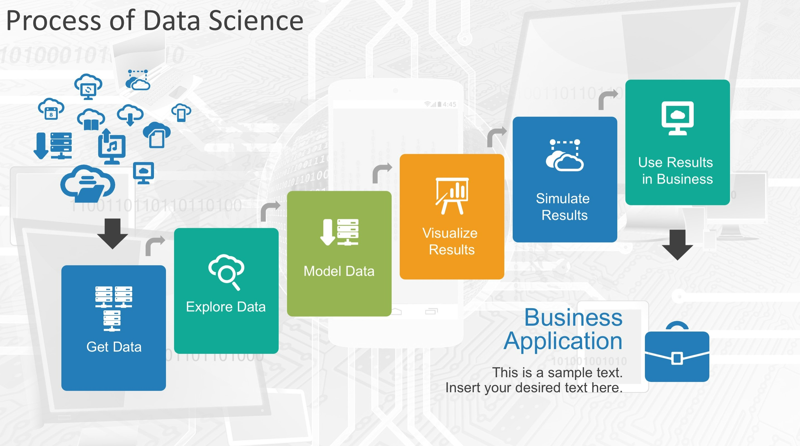
Data Science – Process
Data Driven Decisions
Competitive advantage
Enhanced Business processes
Increased ROI

Slide 5
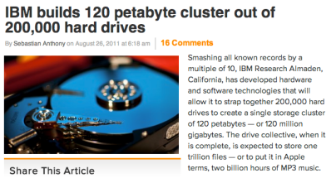
Data, data everywhere…
There's certainly a lot of it!
1 Zettabyte
1.8 ZB
8.0 ZB
800 EB
Data produced each year
logarithmic scale
161 EB
1 Exabyte
5 EB
120 PB
100-years of HD video + audio
1 Petabyte
Human brain's capacity
60 PB
2002
2006
2009
2011
2015
14 PB
1 Petabyte == 1000 TB
1 TB = 1000 GB
References
(2015) 8 ZB: http://www.emc.com/collateral/analyst-reports/idc-extracting-value-from-chaos-ar.pdf
(2002) 5 EB: http://www2.sims.berkeley.edu/research/projects/how-much-info-2003/execsum.htm
(2011) 1.8 ZB: http://www.emc.com/leadership/programs/digital-universe.htm
(life in video) 60 PB: in 4320p resolution, extrapolated from 16MB for 1:21 of 640x480 video (w/sound) – almost certainly a gross overestimate, as sleep can be compressed significantly!
(2009) 800 EB: http://www.emc.com/collateral/analyst-reports/idc-digital-universe-are-you-ready.pdf
(2006) 161 EB: http://www.emc.com/collateral/analyst-reports/expanding-digital-idc-white-paper.pdf
(brain) 14 PB: http://www.quora.com/Neuroscience-1/How-much-data-can-the-human-brain-store

Slide 6
Where does data come from?

Slide 7







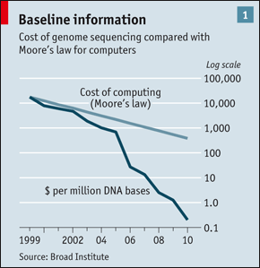
“Big Data” Sources
It’s All Happening On-line
User Generated (Web & Mobile)
Every:
Click
Ad impression
Billing event
Fast Forward, pause,…
Server request
Transaction
Network message
Fault
…
…..
Internet of Things
Health/Scientific Computing

Slide 8
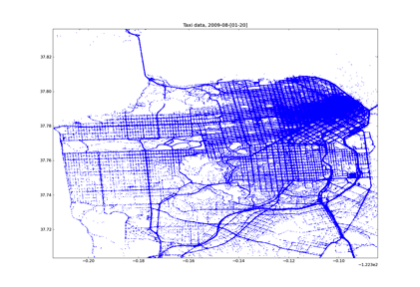
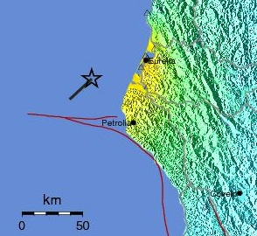

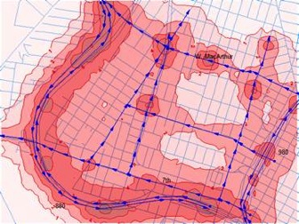
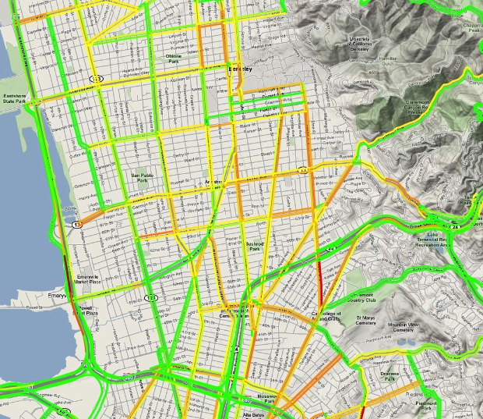

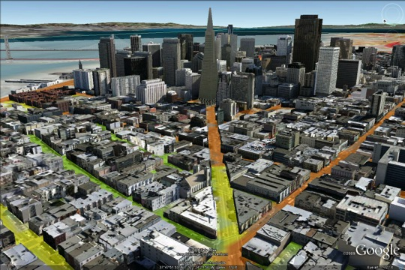
E.g. What can you do with the data? Traffic Prediction and Earthquake Warning
Crowdsourcing + physical modeling + sensing + data assimilation
to produce:
From Alex Bayen, UCB, Director, Institute for Transportation Studies

Slide 9
“Mathematics Covered”
Linear Algebra
Line (2D)
Deals with Linear Equations & it’s representations.
Covers the following topics:
Vectors
Matrices
Solving systems of Linear Equations
Eigen Values & Eigen Vectors
Y = W1X + W0. → Represents equation of a straight line (line)
W1→ slope or gradient
W0→ Y intercept ( Y when X = 0)
W (coefficients or weights)
W1 = change in Y / Change in X
W1 = dY/dX (derivative)
e.g. Y = 2X + 1
W1 = 2, W0 = 1.
C = value of Y, when X = 0 (Y = 1)
M = dY/dX = 2
Plane (3D)
Hyperplane
Y = W0 + W1X1 + W2X2 → Represents equation of a plane.
Here we use partial derivatives to calculate the coefficients or weights
Y = W0 + W1X1 + W2X2 +…WnXn → Represents equation of a hyperplane.
Here we use partial derivatives to calculate the coefficients or weights

Slide 10
Data Science – Role of Mathematics
Linear Algebra – “The Mathematics of Data”. It is used in data processing
Few applications of Linear Algebra in Data science
Array Programming / Vectorized code
Image recognition
Dimensionality reduction
Array Programming / Vectorized code

Slide 11
Data Science – Role of Linear Algebra
Array Programming / Vectorized Code
Simple Use Case: We can certainly claim that the price of a house depends on its size. Suppose know that the exact relationship for some neighborhood is given by the equation:
Price = 10000 + 100*size. This can be represented by the linear equation --→ P = M(S) + C
P - > Price, S -> Size, M is slope & C is the Intercept. (M = 100 and C = 10000 in this case).
Now, if we know the size of 5 houses are 200, 300,400, 500 & 600 we can calculate the price as
House 1 -→ 100*200 + 10000 = 30000, House 2 -→ 100*300 + 10000 = 40000 etc.
Now if we have data for 100 houses, doing by hand will be tedious. Welcome to Programing. By creating a loop and iterating over the sizes, we can reach a solution like below.
house_sizes = [200, 300, 400, 500, 600]. For i in house_sizes: price = 10000 + 100*i print (price). This however may not be optimal with larger data sets. Welcome to Linear Algebra.
We can represent the above data sets in terms of vectors & Matrices.
A (5x2) matrix and a (2x1) vector. Matrix contains a columns of 1s and another with the size of the house. The vector contains the 2 coefficients (100 and 10000).
Therefore, if we go about multiplying them, we will get a vector of length 5 ((5x2) * (2x1) = (5x1)).
The first element will be equal to: 1*10000 + 200*100. This can be represented as
[ NX2 ] . [2X1] = [NX1] which is same as [Inputs] .[Weights (coefficients)] = [outputs]
Observations
By inspecting these expressions, we quickly realize that the resulting vector contains all the manual calculations we tried to make earlier to find the prices.
We’ve got an inputs matrix; a weights, or a coefficients matrix; and an output matrix.
Without diving too deep into the mechanics of it here, let’s note something.
If we have 10,000 inputs, the initial matrix would be (10000x2), right?
But the weights matrix would still be 2x1. So, when we multiply them, the resulting output matrix would be 10000x1.
This shows us that regardless of the number of inputs, we will get just as many outputs.
Moreover, the equation doesn’t change, as it only contained the two coefficients – 10000 and 100
This concept is of paramount importance to machine learning, precisely because of its generality.
So, whenever we are using linear algebra to compute many values simultaneously, we call this ‘array programming’ or ‘vectorized code’. It turns out that vectorized code is much, much faster (than loops for instance). There are libraries such as NumPy that are optimized for performing this kind of operations which greatly increases the computational efficiency of our code.

Slide 12
Useful Links
https://www.analyticsvidhya.com/blog/2019/07/10-applications-linear-algebra-data-science/

